Slide 1
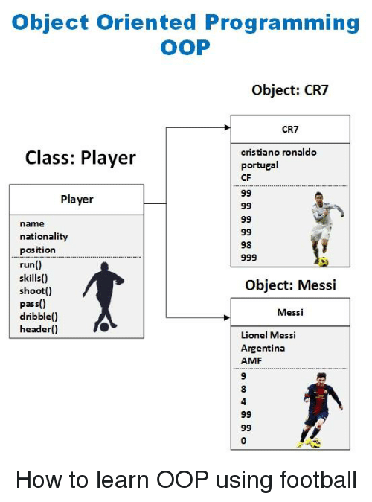

Slide 2
C# Programming Chapter 5
Using compound assignment and iteration statement
Compound Assignment Operators
Variable *= number;
Variable /= number;
Variable %= number;
Variable += number;
Variable -= number;
Compound assignment operator shares the same precedence and right associativity as the simple assignment operator
+= applies to strings, it appends one end the string to the end of the other. NOTE this is the ONLY Compound Assignment
operator that applies to strings.
Example: string name = “john”;
string greeting = “hello”;
greeting += name;
Console.WriteLine(“Hello John”);
There is no need to use the compound addition operator (+=) when adding or subtracting one from a value…why???

Slide 3
While Statement
Use a while statement to run a statement repeatedly for as long as some condition is true
Syntax
While(Boolean expression)
Statement
The Boolean expression is evaluated, if it is true…the statement runs the variable is incremented
Boolean expression is evaluated again, If it is true..
The statement runs again the variable is incremented and each time the Boolean expression is evaluated again,
This continues until the Boolean expression evaluates to FALSE. The program exits the while statement.
While statement and if statement are familiar in the following ways
Expression must be a Boolean expression
Boolean expression must be written in ()
If the Boolean expression evaluates to false, the first time it is evaluated, the statement never runs.
If more than one statement, they must be within a block {}
Example
Int i =0;
while (I < 10)
{
Console.WriteLine(i);
i++
}
1.
Declare a value type
statement
Relational Operator
2.
Conditional while Statement
Boolean Expression
statement
3.
Write value to console
statement
4.
Update Control variable
statement
5.
End of block

Slide 4
While Statement Cont.
While loop should terminate at some point!!
Variable i in example controls the loop, this is called the SENTINEL variable
Without the control variable, what would happen to the loop?
Always use a block when writing a while statement
Like an if statement, If you have more than one statement in your while statement and no curly braces that form the block
To separate the statements, The compiler will not execute the code past the first statement.
Writing For Statements
Syntax
For(initialization; Boolean Expression; update control variable)
statement
Example
For( int I = 0; I < 10; i++);
{
Console.WriteLine(i);
}
Initialization happened ONCE at the beginning of the loop
Then the Boolean expression is evaluated, if true, the statement runs, the update control variable updates,
Then the Boolean expression is evaluated again..and so on.
Note that update occurs before the Boolean expression is reevaluated.
Combines elements of the While Statement

Slide 5
Writing For Statements cont.
You can omit(leave out) any of the three parts of a for statement
No Boolean expression, statement defaults to true and creates and loop that runs for ever.
No initialization and update control variable and you have created a odd while loop
Initialization, Boolean expression, update control variable all must be separated by semicolons
Multiple initializations and multiple updates in a for loop can be provided.
Example
For (int I = 0, j = 10; I <= j; i++, j-- )
{
…….
}
For statement scope
Scope in a for statement is the same as in a method or a class, the variable is declared and comes into
Existence within the scope of the for statement, with in the opening and closing curly braces. You cannot ref
That variable outside the scope of those opening and closing curly braces. That being said, you can reuse a variable
With a same name in different for statements, because they are in different scopes.
Example
For (int i =0; I < 10; i++)
{
}
For (int i= 0; I < 20; i++)
{}

Slide 6
Writing do statements
Where the while and the for statements test the Boolean expression at the beginning of the loop…meaning if it is FALSE
The statements body is not executed, the do statement evaluated the Boolean expression after the iteration, so the body of the
Loop always executes once all the way through.
Syntax
Do
statement
While(Boolean expression);
Just like the other iteration statements, you must place multiple statements in the body of the loop within a block
to avoid compiler complications.
Example
Do
{
Console.WriteLine(i);
i++;
}
While (i < 10);
Continue statement: causes the program to perform the next iteration of the loop immediately, updating before the next iteration
Break statement: is used just like in switch statement, use it to break out of the iteration immediately.
Boolean Expression is at the end of the loop

